Slide 1
Preparing and Planning for PY2024 Recertification

Slide 2
Today, we will cover -
Recertification Background and Process
Prepping and Planning for PY2024's Recertification
Documentation Requirements
Review of Forms that will be used (found on Center’s website)
Recertification-related Terminations
GPMS Data Entry – Recertifications –Commonly Asked Recertification Questions
Most-in-Need (MIN) Background
PY2024 Most-in-Need Updates
Notes:
Today we’ll covering….

Slide 3
What is Recertification and why do we conduct it?
During the SCSEP enrollment process, each job seeker is determined eligible following a review of their income, age, family size, county of residence, and employment status.
After that initial enrollment, the Department of Labor’s (DOL) SCSEP federal regulations require that all grantees/subgrantees collect and conduct an annual review of the job seeker's required documentation to determine their continued eligibility, this process is called Recertification.

Slide 4
The Center for Workforce Inclusion’s Annual Recertification Process
To streamline Recertification and ensure compliance amongst our large subgrantee network, the Center for Workforce Inclusion has instituted a defined period when all Recertifications must take place each Program Year.
Every Center for Workforce Inclusion subgrantee must conduct all Recertifications between August 1 – September 30, 2024.
This time frame allows us to complete the process shortly after the start of the Program Year (July 1) and collect and record the data required to obtain credit for the Most-in-Need performance measure.

Slide 5
The Center for Workforce Inclusion’s Annual Recertification Process
Important note: while Recertification is formally conducted once each year, individual job seekers are required to notify the project any time there are any changes in income, family size, or residency that may affect eligibility and a Recertification may be necessary at that time.
As a best practice, subgrantees should inform job seekers of their responsibility to report increases in income and changes in family status at orientation and each year at Recertification.

Slide 6
PY2024 Recertification – What must be reviewed?
Family size and income of the job seeker are the only eligibility criteria to be updated during Recertification.
Job seekers must submit current Family Size documentation (Family Size Statement, lease, public document, or other).
Job seekers must provide income source documents (either a 6 or 12-month lookback) for each included family member.
Job seekers who are on a break in service must be recertified.
EXCEPTION: You should not recertify job seekers who have open or active Worker’s Comp claim until they return to the program with a doctor’s release.

Slide 7
Getting Ready for Recertification - First Steps
Identify staff members who will assist with Recertification.
Train staff who assist (Important note: job seeker participant staff can assist with the process, but final eligibility determinations must be made by the authorized Project Director.)
Develop a list of all active job seekers who will be recertified.
Reconcile against all active job seekers in the DOL SCSEP Grantee Performance Management System (GPMS).
Ensure all team members who will need it have access to GPMS for data entry.

Slide 8
PY2024 Recertification Documents (all will be available on the Center’s website)
Recertification Instructions
Recertification Checklist and Readiness Calendar
Recertification Notice for Job Seekers
Options for Recertification Appointments
Income Worksheet
Policy and Procedure Manual, Section 203, Eligibility Requirements (includes PY2024 Income Eligibility tables)
Policy and Procedure Manual, Section 204, Computing Income for Eligibility (includes definitions of family size and includable and excludable income sources)
Family Size Form
Self-Attestation for Zero Income (only used if the job seeker has no includable income)
Record of Offer of Physical Exam Form
Release Form
Termination Notice – Ineligible at Recertification
Termination Notice – Failure to Recertify
Notes:
In addition to the forms needed to complete MIN updates, here is a list of Recertification forms.
Eligibility Doc Case Note Form can only be used as last resort in PY2022

Slide 9
Important Recertification Process Changes in PY2024 – Subgrantee options for PY2024 Recertification appointments
For PY2024 Recertifications, SCSEP subgrantees must coordinate appointments that allow for direct, face-to-face interaction with the job seeker:
Option 1:
Meet in person. Job seeker will provide hard copies of all source documentation – expected and strongly preferred by the Center
Option 2:
Meet remotely via video conference. Job seeker will transmit all required documentation by submitting electronically or by mail, including required signatures (ex: via printing forms, signing, and scanning/emailing back).
IMPORTANT: Any electronic transmittal of documents must be conducted through a secure and encrypted process to protect Personally Identifiable Information (PII).

Slide 10
Getting Ready - Prepare and send notice and packets to job seekers
To coordinate Recertification appointments, subgrantees must prepare and send Recertification Notice for Job Seekers letters and Recertification packets to all active job seekers.
Any appointment notices sent should clearly identify all appointment details, including the date, time, location and/or method of meeting, and what documentation must be provided to the project.

Slide 11
Getting Ready - Assemble Document Packets
Income Worksheet
Family Size Form
Record of Offer of Physical Examination
SCSEP Self Attestation Form for Zero Income (only used when a job seeker has zero includable income)
SCSEP Release Form
MIN Revalidation Form
MIN Self Attestation Forms
Third-Party Attestation Forms
Notes:
Depending on the method you choose to complete recert, you may need some of the new forms that were introduced last year.
Like the Mail In Attest, eligibility determination case note form, etc.

Slide 12
Conduct appointments
Work through required forms
Collect copies of source documents and signatures
Are they also updating reassessments and IEPs?
After appointments;
Enter all data in GPMS
Double-check for Quality Assurance
Submit notice to anyone who is no longer income ineligible

Slide 13
Recertification-related Terminations

Slide 14
Terminations at Recertification
There are two reasons why a job seeker may be terminated during Recertification, being found over-income and failure to recertify.
Both of these termination circumstances require that written notice be sent to the job seeker, their Host Agency Supervisor, and to the Center.
Three letter templates will be available for use on the Center’s website:
PY2024 Recertification_Termination Notice_Over-income
PY2024 Recertification_Notice of Missed Appointment
PY2024 Recertification_30-day Notice of Termination for Cause_Failure to Recertify

Slide 15
Terminations for Over-income status – Explanation
Recertification requires that subgrantees review source documentation and calculate income levels for all included family members to determine continued eligibility.
A job seeker may be found ineligible for continued enrollment when:
The job seeker has attained additional includable income during the preceding 6 or 12 month look back period that exceeds 125% of the established Federal Poverty Guidelines for the year.
The job seeker has had a change in family status that causes their includable income to exceed 125% of the established Federal Poverty Guidelines for the year.
Under these circumstances, the job seeker must be terminated from SCSEP.
IMPORTANT NOTE: Determinations of ineligibility cannot be based on anticipated changes in income or family size; they must be based on source documentation.

Slide 16
Terminations for Over-income status – Process
Steps to take:
Subgrantees must send job seekers who are determined ineligible at Recertification a written 30-day Notice of Termination. Customize the PY2024 Recertification Termination Notice Over-income letter template (available on the Center’s website) for the individual job seeker.
Job seekers who are being terminated for ineligiblity are allowed to continue training at their Community Service Assignment for 30 days.
The date of exit must be entered in GPMS.

Slide 17
Please Note -Terminations for over income status is an Exclusion
Remember:
Capturing Exclusions lowers the total number of exits, which improves our overall network performance.
Not capturing Exclusions at exit hurts your performance and the Center’s performance.

Slide 18
Terminations for Failure to Recertify
Important – subgrantees must offer job seekers who miss their first appointment the opportunity to reschedule before resorting to termination. SCSEP is a person-centered program and there may be valid reasons why the job seeker was unable to attend the appointment without advance notice.
Steps to take after a missed appointment:
Customize and send the PY2024 Recertification Notice of Missed Appointment letter (available on the Center’s website).
2. The Center expects project staff to attempt to contact a no-show job seeker at least
three times. Be PRO-ACTIVE.
3. The additional attempts at contact can be made by phone or email, depending on any
established preference.
4. Retain a copy of the Notice of Missed Appointment letter in the job seeker’s file and use
case management notes to document all efforts made to reach the job seeker.

Slide 19
Termination – Failure to Recertify
Final step – 30-day Notice of Termination for Cause sent:
If the job seeker is not responsive to your attempts to reschedule, the subgrantee can place them on a break in service and send the “30-day Notice of Termination for Cause – Failure to Recertify” letter.
The break in service must be entered in GPMS to stop their Durational Limit clock.
3. Job seekers may not be terminated until 30 calendar days after the subgrantee
has provided the job seeker with written notice.
4. Job seekers being terminated for failure to recertify are NOT allowed to
continue training. They will remain on a break in service until recertification
has been completed or the date of exit.
5. The date of exit must be entered in GPMS.

Slide 20
GPMS Data Entry

Slide 21
Planning for Quality Assurance
Entering all data accurately into GPMS is essential for documentation of eligibility and data quality and validation purposes.
Develop a system for ensuring quality assurance; if necessary, determine additional staff who will double check the work once entered.
Continuous data entry into GPMS is strongly encouraged!

Slide 22
GPMS data entry for Recertification
A user with the role of Case Manager or above may initiate the Recertification Process in GPMS.
Users may edit data submitted in the recertification prior to submission approval
Recerts will be approved by the Supervisor or higher-level user.

Slide 23
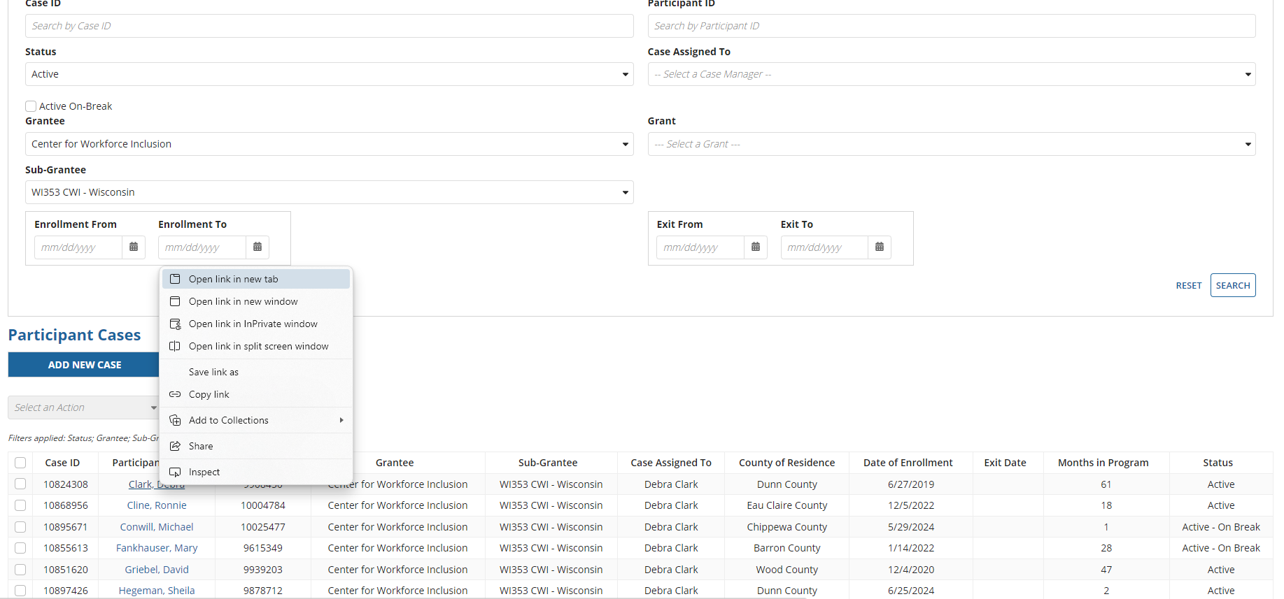
GPMS data entry for Recertification
To begin entering data into GPMS a CM or Supervisor will:
Open your SCSEP Cases and Right click on Job Seeker Name to open link in new tab

Slide 24
GPMS data entry for Recertification
You now have a new tab open. Click on new tab
(When you have completed entering the information, you may close out this tab)

Slide 25
GPMS data entry for Recertification
Click on Related Actions to enter the Recert Information

Slide 26
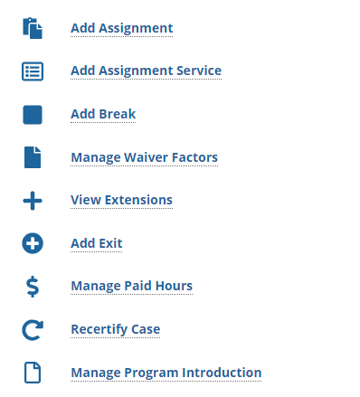
GPMS data entry for Recertification
Click on Recertify Case

Slide 27
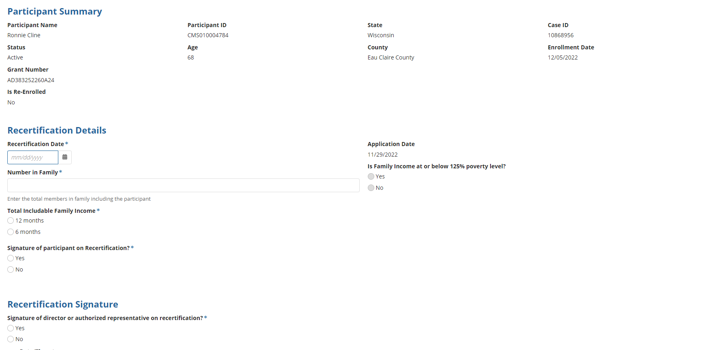
GPMS data entry for Recertification
Enter Recertification Information

Slide 28
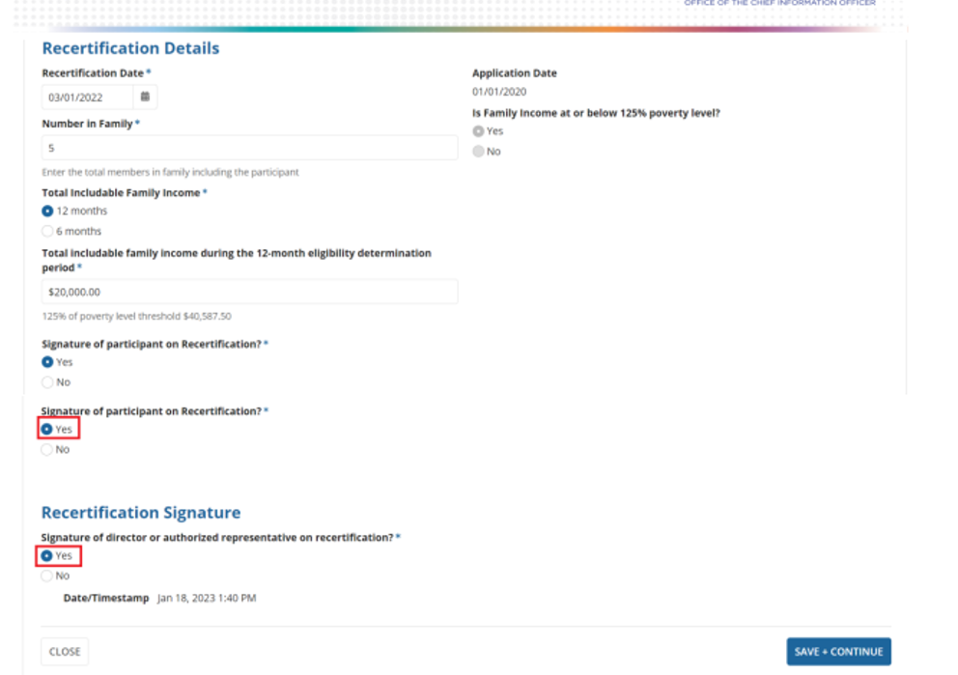
GPMS data entry for Recertification
Enter:
Recert Date
Number in Family
Income for 6 or 12 mos.
Do you have all Signatures?
Yes or NO
Choosing “yes” on last two will allow you to SAVE & CONTINUE
Choosing “no” on last two will not let you SAVE & CONTINUE
Notes:
If a Case Manager enters data, they will need to let the Supervisor know they have completed the process.

Slide 29
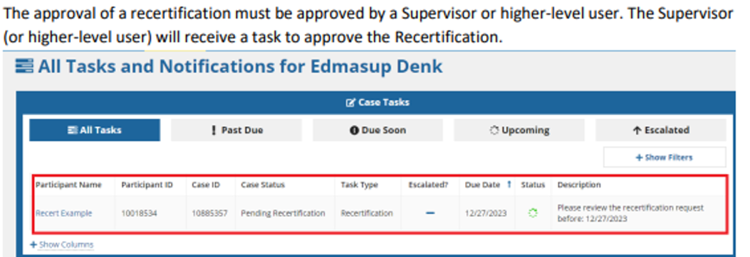
GPMS data entry for Recertification

Slide 30
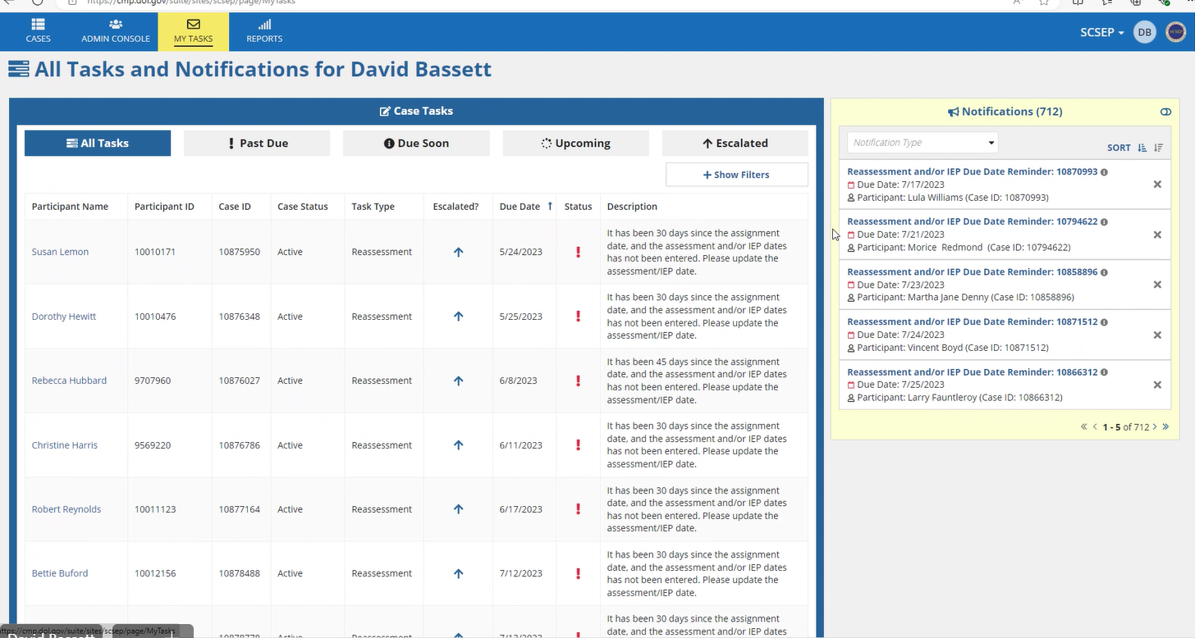
GPMS data entry for Recertification
Open up MY TASKS and click on +show filters

Slide 31
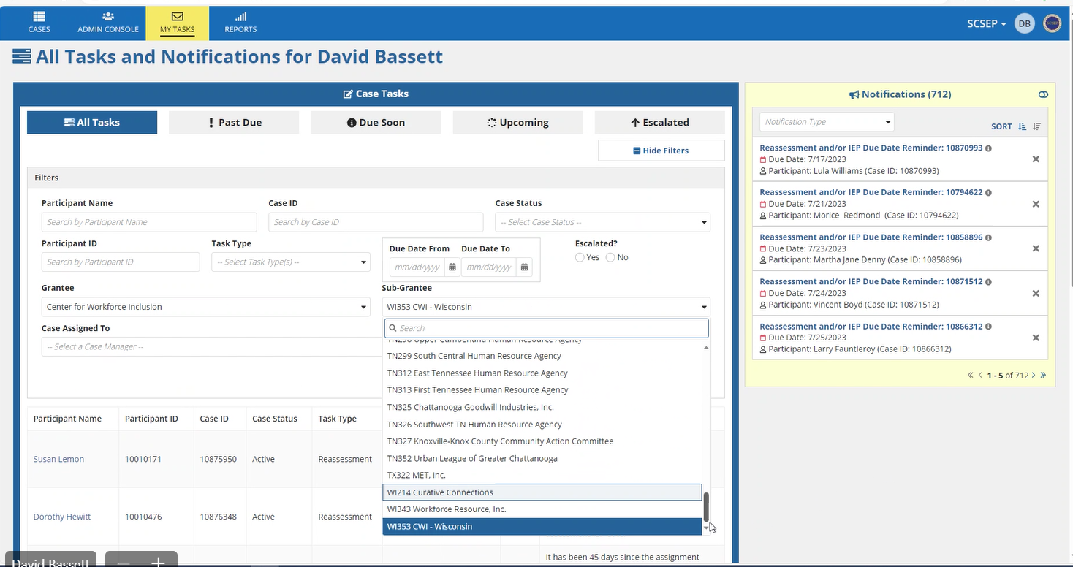
GPMS data entry for Recertification
Enter Grantee and Sub Grantee and hit SEARCH

Slide 32
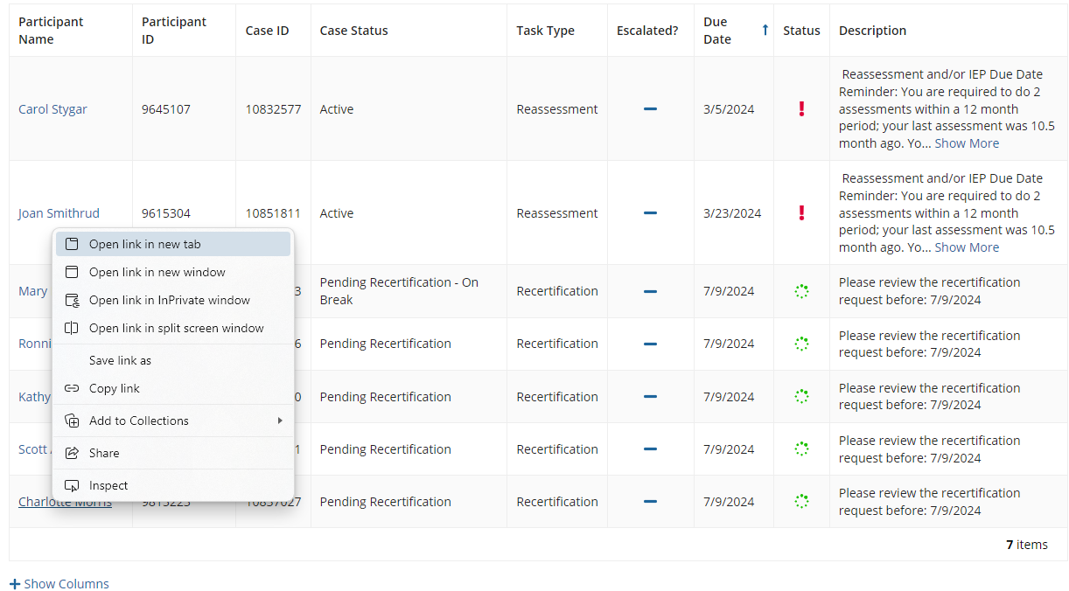
GPMS data entry for Recertification
Scroll down to name of job seeker to be approved and RIGHT click on the name. A new tab will open up at the top.

Slide 33
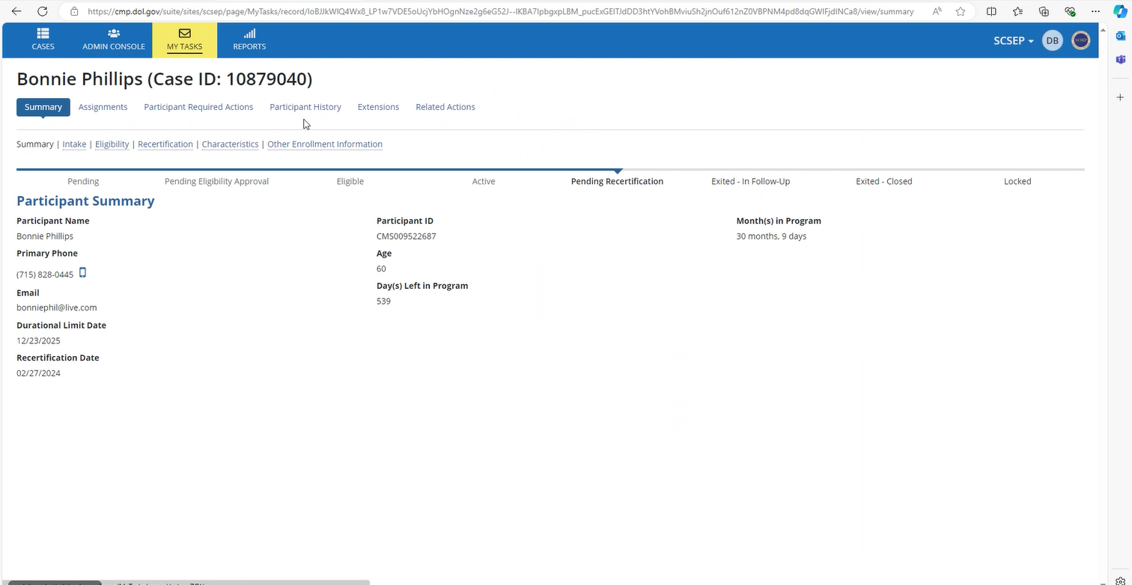
GPMS data entry for Recertification
Click on the new tab the case will open. Click on Recertification.

Slide 34
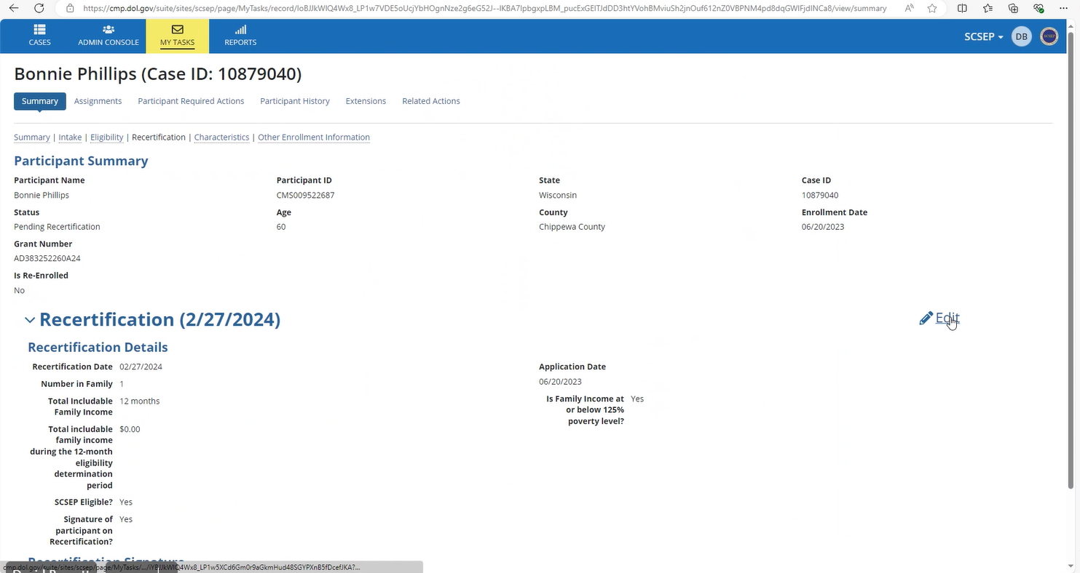
GPMS data entry for Recertification
The Recertification approval page will open. Click on EDIT

Slide 35
GPMS data entry for Recertification

Slide 36
GPMS data entry for Recertification
Scroll to the bottom to Recertification Signature and if all information is correct, click on YES.
After clicking on YES, click SAVE & CONTINUE

Slide 37
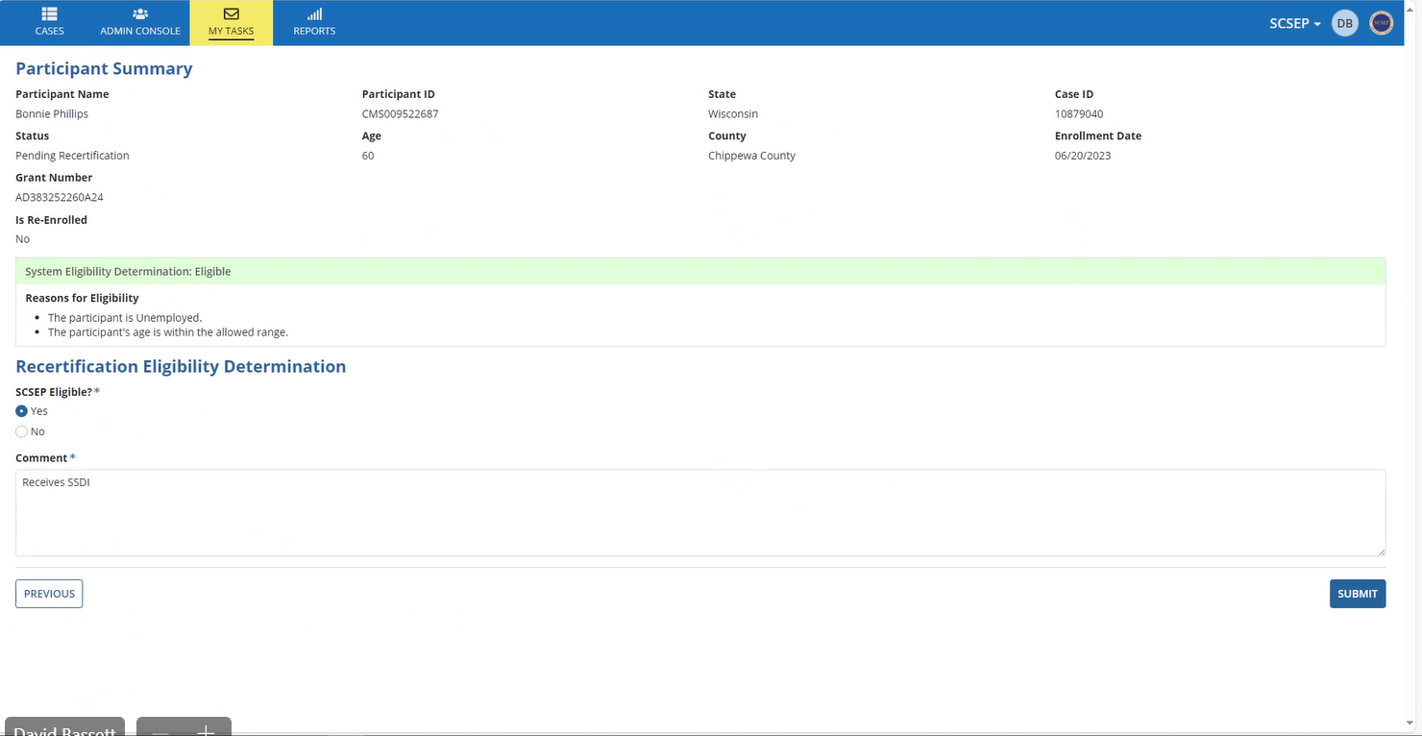
GPMS data entry for Recertification
It will open a Summary Page for you to submit the Recertification. Click on SUBMIT at the bottom.

Slide 38
GPMS data entry for Recertification
A page comes up asking if you are sure you want to submit the form?
If you want to change anything, click NO You may then go back and make any changes, or choose why they are no longer eligible
If you are sure everything is good, click YES

Slide 39
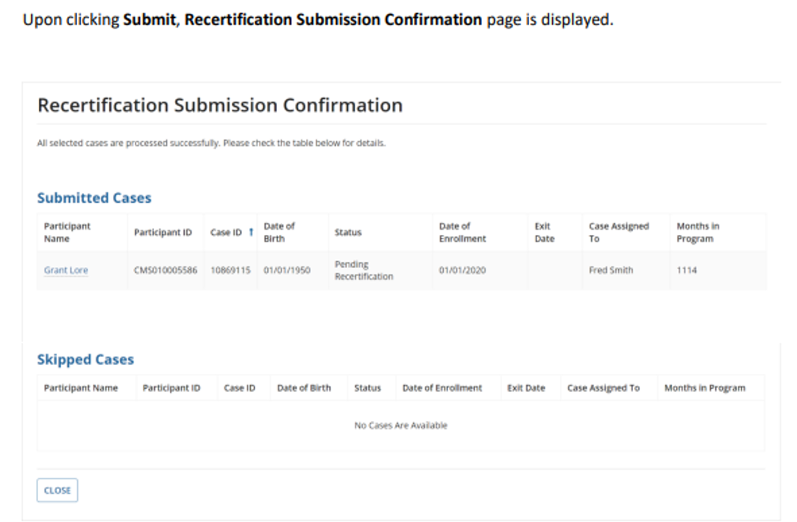
GPMS data entry for Recertification

Slide 40
Commonly Asked Recertification Questions

Slide 41
SSDI & Full Retirement Age
Question 1:
For job seekers who receive Social Security Disability Income (SSD(), should this income benefit be counted when they turn 65?
Answer:
No.
SSDI benefits convert to Retirement Benefits the month the job seeker reaches Full Retirement Age.
The Full Retirement Age is no longer 65.
Birth Year | Full Retirement Age
1937 | 65
1938 | 65 and 2 months
1939 | 65 and 4 months
1940 | 65 and 6 months
1941 | 65 and 8 months
1942 | 65 and 10 months
1943 - 1954 | 66
1955 | 66 and 2 months
1956 | 66 and 4 months
1957 | 66 and 6 months
1958 | 66 and 8 months
1959 | 66 and 10 months
1960 and Later | 67
Notes:
Over the years, we’ve gotten some good questions, and we’d like to review some common questions. You can always contact your PO if have a question about anything.

Slide 42
Question 2:
If I’m recertifying someone on September 15th and they will receive their Social Security check on September 27th, how do we count it on the worksheet?
Do we put $0 for September?
Would this person have 5 months of Social Security if I’m using the 6-month annualized method?
Answer:
No. The lookback months are not the same as calendar months; they will nearly always bridge two calendar months.
A job seeker’s income is computed by calculating the includable income received during the
12-month period ending on the date of Recertification OR annualized income for the 6-month period ending on the date of Recertification.
Annualizing means taking the figure calculated for 6-months and multiplying it by two on the Income Worksheet.
DOL requires subgrantees to use whichever method is more favorable to the individual.
1938
65 and 2 months
Notes:
Here is a question about the look back period for calculating income….

Slide 43
Lookback Period
When completing an eligibility determination conducted on September 15th, 2024, the income worksheet for a 6-month lookback should be completed as follows:
Month | Dates | Income to be included:
1 | Sep 15^{th,} 2024- Aug 16th, 2024 | All income received between 09/15/24 and 08/16/24
2 | Aug 15th, 2024 – Jul 16th, 2024 | All income received between 08/15/24 and 07/16/24
3 | Jul 15th, 2024– Jun16th, 2024 | All income received between 07/15/24 and 06/16/24
4 | Jun15th, 2024 – May16th, 2024 | All income received between 06/15/24 and 05/16/24
5 | May 15th, 2024 – Apr16th, 2024 | All income received between 05/15/24 and 04/16/24
6 | Apr15th, 2024– Mar16th, 2024 | All income received between 04/15/24 and 03/16/24

Slide 44
Question 3:
How do I properly round a Social Security benefit amount that includes cents?
Answer using an example:
The job seeker's full monthly Social Security benefit before any deductions is $1563.70
Round $1563.70 down to the nearest dollar = $1,563
Record the rounded amount of $1,563 on the Income Worksheet
REMEMBER: This is the only time you round!
Notes:
We’ve always been taught to round up or down, but DOL requires that we always round down, no matter the amount of cents.
Always round down by dropping the cents.

Slide 45
Question 4:
Do I need a new Social Security award letter if the job seeker is disabled?
Answer:
Yes!
Disability benefits from Social Security and other sources are excludable income. A job seeker’s income could change from Disability to regular Social Security, which is includable income (at 75%) for SCSEP.
Or they could lose their disability status as a result of a Continuing Disability Review.
These types of changes would impact their earnings and could potentially lead to ineligibility, so updated source documentation is required.

Slide 46
Question 5:
What if a job seeker has previously provided documentation of an annual pension?
Answer:
The Center recommends obtaining all new income documentation; however, if the pension documentation was an annual statement, you may make a copy of the documentation previously submitted.
If the pension statement was short of annual, ex: quarterly, you will need a new document verifying the pension income.

Slide 47
PY2024 Most-in-Need Updates

Slide 48
MIN Characteristics Overview
There are now 14 MIN characteristics, the most recent addition was Formerly Incarcerated, which was added in March 2021.
Some characteristics can only be captured at the point of enrollment and never need updating.
Others need to be updated at the beginning of each Program Year to obtain "credit" for this performance measure.
Updating MIN factors annually is necessary for each SCSEP subgrantee to meet the MIN goal.
The Center requires that MIN updates be conducted during annual Recertification.

Slide 49
Six MIN characteristics can only be captured at enrollment:
Veterans or qualified spouses
Low employment prospects
Homeless or at risk of homelessness
Failed to find employment through the One-Stop delivery system’s Title I services
Live in rural areas
RUCA TABLE:
SCSEP Processes | BCT Partners LLC (scsep-help.com)
Have a disability
Notes:
Some of the MIN can only be captured at enrollment, and they are: READ
Will not go into detailed definitions or documentation required for these now – see MIN Guidebook or the Data Validation Handbook.
Since these can only be captured at enrollment, it’s very important to do a thorough assessment interview with participant to capture them at that time
We're not going to review these in detail today, will focus only on the MIN that need to be updated at the beginning of each program year.
But there is more information about these MIN along with tips on ways to capture them in the MIN Guidebook on our website. That Guide was also sent with the big Recert email Josh sent in early July.

Slide 50
Eight MIN characteristics can be captured at any time but must be updated annually during Recertification:
Formerly Incarcerated
Has a severe disability
Is frail
Has limited English proficiency*
Has low literacy skills*
Is age 75 or older
Old enough for Social Security retirement but not receiving it
Has severely limited employment prospects in an area of persistent unemployment
* If captured at enrollment there is no need to update
Form can be seen on the Center’s website
https://www.centerforworkforceinclusion.org/toolkit/scsep-forms in SCSEP Forms under Other Forms and Reference Information
Notes:
There are now 8 MIN that can be captured at any time, but MUST be updated annually for you to retain credit.
Great news as announced in Chris Garland’s email on 6/4 -- we have a New MIN characteristic. Effective 3/25/21 we can now capture ‘formerly incarcerated’ – many of you and the Center have advocated for that to be a MIN for years since you serve many who have previously been in jail or prison. We’ll review the definition in a moment.
READ list
These are the MIN that reset in SPARQ each year on July 1, so unless you update them, you lose credit for this important performance measure. The Center requires these updates be done early in the program year or before someone exits to regain that credit.
Please note the two that have an asterisk – have limited English proficiency and have low literacy skills. If either of those is captured at enrollment you will not have to update. What does it mean? Normally, all these MIN that are updatable are reset on SPARQ at the beginning of each program year and therefore you need to revalidate them. In the case of these two MIN, if you captured them at enrollment then it will remain in the system. However if not captured at enrollment and you update either of these MIN at revalidation then you will have to update it every year thereafter.
If any of these 8 MIN characteristics are not captured due to an oversight, you can capture it at any time when you become aware that the participant had the MIN characteristic.
Also with any of the MIN characteristics that were documented in the file but were not entered on SPARQ, you can correct the participant record on SPARQ. If done within the program year and before the program year closes (normally August/September) you can get the credit. After that you can amend but will not get the credit.
To update and Revalidate these MIN, use the updated MIN Revalidation Form that now includes Formerly Incarcerated. The All in One Self Attest has also been updated to include Formerly Incarcerated.
Form can be seen on the Center’s website
https://www.centerforworkforceinclusion.org/toolkit/scsep-forms under Other Forms and Reference Information

Slide 51
PY2024 Recertification and MIN Updates
Timeframe for completion:
The Recertification and MIN update process can begin on August 1st and must be completed by September 30th.

Slide 52
Questions and Answers
Use the chat or unmute yourself to ask a question!

