Slide 1
Individual Employment Plans and Case Management
Tuesday June 11, 2024

Slide 2
Goal
Initial Assessment
Initial Individual Employment Plan (IEP)
Reassessment/IEP Update
Transitional Assessment/IEP
Key Forms (Tools) for Job Seeker Success

Slide 3
Key Forms
Initial Assessment
Completed during enrollment and prior to CSA placement.
Initial IEP
Completed within 30 days of enrollment and MUST contain an employment goal.
Reassessment/IEP Update
Updated at least once every 6 months.
Transitional Assessment and IEP
12 months prior to Individual Durational Limit (IDL) exit date.
Must be updated 3 more times - at 6 months, 90 days, and 30 days out (a total of 4).

Slide 4
Assessments and Individual Employment Plans
Support Project Staff to develop strong Community Service Assignments (CSA).
Identify training needs and opportunities for job seekers.
Identify unsubsidized employment opportunities and/or prospects.
Pinpoint any personal, social or other barriers to employment and identify supportive services that will enhance the participant’s experience in SCSEP.
Establish a plan of action, including goals, upskilling and reskilling training opportunities to enhance unsubsidized employment in a living wage position.

Slide 5
Initial Assessment
Project Staff are required to conduct an Initial Assessment for each job seeker at the time of enrollment and prior to placement in a Community Service Assignment (CSA).
The Initial Assessment helps build the job seeker's IEP. It includes:
Work history, education and training history
Occupational preferences and Supportive Services needed
Training needs and aptitude assessments
Job readiness
Supportive Services

Slide 6
Developing a Strong Assessment
Start with a blank sheet of paper to take interview notes.
Ask the job seeker easy questions; then “probe” for more information with follow-up questions.
Use information gathered to complete the Initial Assessment.
Determine the job seeker's supportive services needs and referral sources.
Determine job seeker training and employment needs and referrals.
Consider appropriate Host Agencies for job seeker placement.

Slide 7
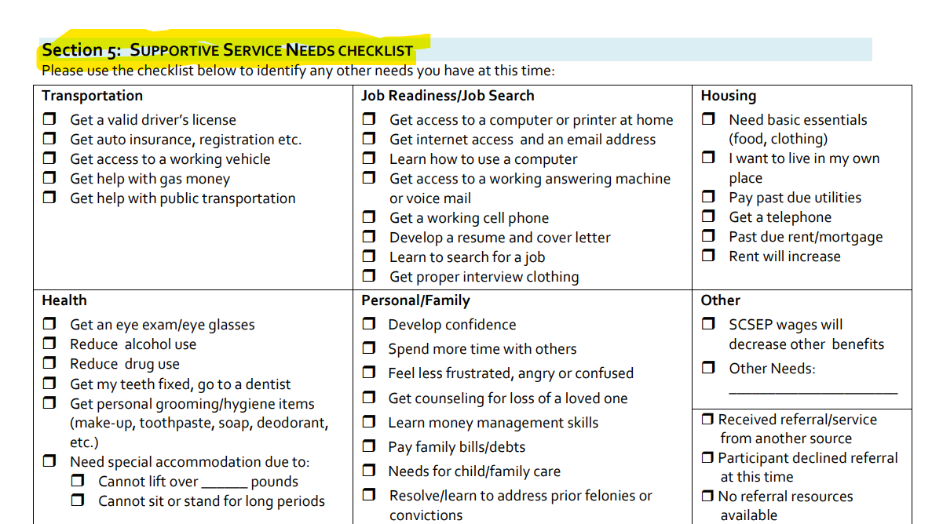
Supportive Services

Slide 8
Initial Individual Employment Plan
The IEP should reflect the job seeker's needs and interests and helps to outline initial training and employment goals.

Slide 9
IEP Short Term Goals

Slide 10
SMART Goals
Specific
Measurable
Achievable
Realistic
Time-framed

Slide 11
Example of Strong IEP Goals
“To search for three jobs that I would like to apply and check requirements and skills for the jobs. Then I will determine which skills I need to strengthen and discuss them with my case worker by October 2, 2024.”

Slide 12
Initial IEP and SMART Goals

Slide 13
Example of Vague Goals and Action Steps:
Goal: Get a clerical job | Timeframe:
Action Step 1: Improve clerical and computer skills | 6 months
Action Step 2: Continue to train at host agency | On-going
Goal: Obtain employment in customer service | Timeframe: 2 years
Action Step 1: Practice good customer service | Continuously
Action Step 2: Look for computer training | 2 months
Goal: Work in food service
Action Step 1: Do job searches | Every pay period
Initial IEP ACTION PLAN

Slide 14
Example of Specific Goals and Action Steps:
Goal: Part-time employment as general office clerk | Timeframe: 3/31/23
Action Step 1: Enroll in Level II computer training class at library | 12/21/22
Action Step 2: Participate in job club offered at One-Stop once per week | 3/31/23
Goal: Employment at a bank customer call center | Timeframe: 3/31/23
Action Step 1: Learn multi-line phone system at host agency | 1/31/23
Action Step 2: Register and attend customer service training at (fill in location) | 2/15/23
Goal: Obtain part-time employment in a bakery | Timeframe: 4/1/23
Action Step 1: Identify and research list of local bakeries, requirements of positions | 12/1/22
Action Step 2: Meet with case manager once per week to review job searches and apply for positions | 3/31/23
Initial IEP ACTION PLAN

Slide 15
Example of Specific Job Readiness/ Employment Action Steps
Record professional message on home answering machine and/or cell phone
Create email account with professional email address
Remove unprofessional content from online profile
Review the “O*Net” online occupation guide for the position you are interested in and identify all of the tasks, related to the job, that you are currently capable of and have some experience doing.
Review the “O*Net” online occupation guide for the position you are interested in and identify all of the tasks and/or skills, related to the job, that you need to learn and/or practice in order to become proficient enough to be successful in your desired position.
Provide updated resume to Project Director for review
Contact One Stop for assistance
Meet with SCSEP staff for assistance finding food resources
Utilize O*NET information
Practice interviewing (mock interviews) at fill in location, fill in frequency
Develop a 20 second elevator speech that you can use to introduce yourself to prospective employers
Develop a list of 5 people you can call and/or meet with to practice your elevator speech and to discuss your employment prospects. Include names, phone numbers, and email addresses.

Slide 16
Example of Specific Training and/or Supportive Services Action Steps
Locate a fill-in type of training program (i.e. computer, Excel, GED, etc)
Obtain certification in fill in type at fill in location (i.e. community college, etc)
Register for fill-in type of class(es) (i.e. ESL, GED, etc)
Start attending fill-in type of class(es)
Complete fill-in type of class(es)
Obtain certification in fill in type
Locate a tutor to help you with your fill-in name of study topic (i.e, math)
Meet with tutor and work together to determine how may sessions you’ll need to schedule with him or her over the next fill-in number of weeks/months
Report back to your case manager how many fill-in name of study topic (i.e, math) sessions you will need with the tutor and the length of each session
Schedule fill-in name of study topic (i.e, math)sessions with your tutor
Complete fill-in name of study topic (i.e, math)sessions with your tutor
Schedule an appointment with fill-in agency name (Dress for Success, The Women’s Alliance, etc.) to secure an outfit to interview in

Slide 17
Reassessment/IEP
Project staff must conduct at least one Assessment/IEP update per job seeker every 6 months.
Remember, the very first job seeker assessment and Individual Employment Plan is the Initial Assessment and Initial IEP; all subsequent assessments are reassessments with IEP updates.

Slide 18
Key Opportunities: Re Assessement/IEP
Build updates based on previous IEP
Revise IEP goals
Addresses identified barriers
Provides referral to other services as appropriate
May identify a new CSA
Identifies additional training & skills required to become job ready

Slide 19
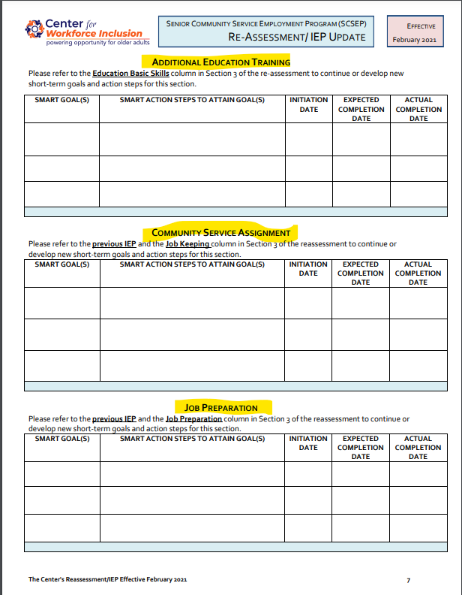
Reassessment/IEP
Record SMART Goals

Slide 20
Transitional Assessment/IEP
The Transition Assessment/IEP differs from the typical SCSEP assessment in that it may include the job seeker's finances. The goal of this review is to help the job seeker determine if they will have sufficient financial resources when they leave the program.

Slide 21
Transitional IEP Completion Schedule
The Transitional Assessment and IEP needs to be created 12 months before the participant’s four-year Individual Durational Limit date and updated three times:
6 months after the initial Transitional Assessment and IEP.
90 days before the Individual Durational Limit exit date.
30 days before the Individual Durational Limit exit date.
A job seeker may refuse to participate in this process, in that case, you must document the refusal via a case note on the transitional assessment form.

Slide 22
Transitional Assessment

Slide 23
Questions???
Break

