Slide 1
Foundations of SCSEP
PY2023 New Project Directors Training
June 4, 2024
Presented by: Alicia Black

Slide 2
This training will cover…
General SCSEP Background and the Center’s Subgrantee Network
SCSEP Terminology and Acronyms
Policy and Guidance Resources
Center for Workforce Inclusion SCSEP Portal
Workforce Inclusion Grant Agreement

Slide 3
SCSEP General Background
SCSEP is a community-service and work-based job-training program for older Americans.
Authorized by the Older Americans Act of 1965 (59 years old in 2024), the program provides training for low-income, unemployed older adults who have barriers to employment.
SCSEP is the only federally-funded workforce training program that solely serves older adults.

Slide 4
SCSEP General Background
SCSEP is funded through annual appropriations from the federal Department of Labor. PY2023 appropriations were more than $401 million.
SCSEP funds are allocated to and administered through grants to all state governors, Puerto Rico, the District of Columbia, and four territories.
SCSEP funds are also competitively awarded to 19 national non-profit agencies for services across the country, called "national grantees." The Center for Workforce Inclusion is a national grantee. National grantees compete for awards every four years through a process called National Competition.

Slide 5
About the Center's SCSEP Subgrantee Network
The Center currently operates SCSEP in over 400 counties in 13 states (67% are rural counties).
The Center was allocated 4,840 Authorized Positions (AP) in PY2023.
Comprised of 52 subgrantees from workforce-development, nonprofits, Area Agencies on Aging, faith-based groups, community colleges, and social service agencies.
30 Center subgrantees have been funded by the Center for 20 years or longer.
Notes:
States we serve in PY2022 are:
ALABAMA
ILLINOIS
INDIANA
MASSACHUSETTS
MARYLAND
MINNESOTA
MISSISSIPPI
NORTH CAROLINA
NEW YORK
TENNESSEE
TEXAS
WISCONSIN

Slide 6
Subgrantees and Program Officers
Each Subgrantee has an assigned Program Officer (PO). ​
Your PO serves as a single point of contact:​
POs will handle all requests, concerns, or inquiries from your project.​
POs will also coordinate your “care” with other Center staff.​
POs will provide timely and accurate communication on all types of SCSEP issues.​
Your assigned PO will work with you on:​
SCSEP Operations and Performance​ - monitoring expenditures and developing and tracking goals through Performance Strategy Plans.
Technical Assistance – responses to your questions to help you to meet Performance Goals and more​.
​

Slide 7
SCSEP Terminology – Language Matters!
WHY? The Center has adopted more inclusive, modern, positive language, aligning with workforce initiatives.
The individuals we serve are job seekers, or sometimes participant job seekers (no longer “participants,” “clients,” “senior aides,” or “candidates”).
We will use the word “older” to describe the population we serve (as opposed to “senior”), for example: “older worker,” “older American,” “older participant job seekers”.
Notes:
Next, I want to talk a bit about language. Working with federally-funded programs can make you feel like you’re learning a whole new language.
As with most federal programs, there will be some terminology and acronym uses that are unique to our work. Program Officers always try to be conscientious of this and spell out acronyms at least the first time they are used.
One of the most common terms you’ll hear us use is job seeker. I'd also like to mention that though the Center has adopted the term job seeker to reference the people we serve, the Department of Labor still uses the term participant, so you may hear or see the term participant referenced during the training series.

Slide 8
Common Terminology and Acronyms
American Job Centers (AJC)
Community Service Assignment (CSA)
Equitable Distribution (ED)
Grantee Performance Management System (GPMS)
Host Agency (HA)
Individual Employment Plan (IEP)
Individual Durational Limit (IDL)
On-the-Job Experience (OJE)
Participant Wages and Fringe Benefits (PWFB)
Unsubsidized Employment (UE)
Data Validation (DV)

Slide 9
American Job Centers (AJC)
(also called One Stops or Career Centers):
A combination of agencies that operate through a single place or system in a local area to provide applicable core services and access to other programs and services carried out by the American Job Center/One-Stop partners. The AJC serves both job seekers and employers. The principal operator of the AJC is usually the Employment Service office. Other partners typically include training and educational service providers. SCSEP projects may have staff or SCSEP participant staff collocated at the AJC.

Slide 10
Community Service Assignment (CSA)
Part-time, temporary training at Host Agencies paid with grant funds through which enrolled job seekers are engaged in community service and receive work experience and job skills that can lead to unsubsidized employment.
Each job seeker must have a written CSA description associated with their training.

Slide 11
Data Validation (DV)
An annual Department of Labor compliance activity that requires grantees to collect a sample of records from subgrantees and review them for accuracy – grantees must review the samples to determine whether sufficient documentation was obtained and entered in GPMS at the time of enrollment to establish program eligibility and whether required activities took place and were recorded in GPMS during a job seeker’s time on the program.

Slide 12
Equitable Distribution (ED)
The DOL allocates Authorized and Modified Positions to grantees in this annual process. DOL uses a mathematical formula derived from census data, which lists the number of expected SCSEP positions in each jurisdiction – typically a county or incorporated city – based on the demographics of that jurisdiction against federal appropriations for each year.
The resulting number is provided to subgrantees as their Authorized or Modified Position level that should guide enrollment activity in each county served.

Slide 13
Grantee Performance Management System (GPMS)
The DOL Case Management System where all job seeker data is entered. Replaced former system, SPARQ, in July of 2022.

Slide 14
Host Agency (HA)
A non-partisan, non-profit or governmental organization that we partner with to provide community service training assignments for SCSEP job seekers.
Organizations eligible to act as host agencies are public entities operated by non-profit agencies or units of government with 501(c)(3) designations.

Slide 15
Individual Employment Plan (IEP)
An individualized plan for a SCSEP job seeker that is based on an assessment conducted by project staff. The IEP and subsequent updates are developed in collaboration with the job seeker.
The first IEP must include an appropriate employment goal, objectives that lead to the goal, a timeline for the achievement of the objectives; and be jointly agreed upon with the job seeker.

Slide 16
Individual Durational Limit (IDL)
The maximum time period a participant may be enrolled in the Center’s SCSEP, which is 48 months/4 years.
The Center does not provide IDL waivers or extensions.
When a job seeker needs to be absent for more than three consecutive training days, they must be placed on a break in service to stop their Durational Limit clock.

Slide 17
On-the-Job Experience (OJE)
A specialized provision of Community Service Assignments that allows SCSEP to contract with for profit agencies with the ultimate goal of the agency hiring the job seeker after an established training period.

Slide 18
Participant Wages and Fringe Benefits (PWFB)
Both the Older Americans Act and the Code of Federal Regulations that govern SCSEP (20 CFR Part 641) state the requirement that 75 percent of SCSEP funds made available through a grant must be used to pay for the wages and fringe benefits of job seekers training under SCSEP projects.

Slide 19
Unsubsidized Employment (UE)
The ultimate goal of SCSEP which entails job seekers exiting the program for placement in unsubsidized, or regular, jobs. You may also hear UE referenced as a livable wage job.

Slide 20
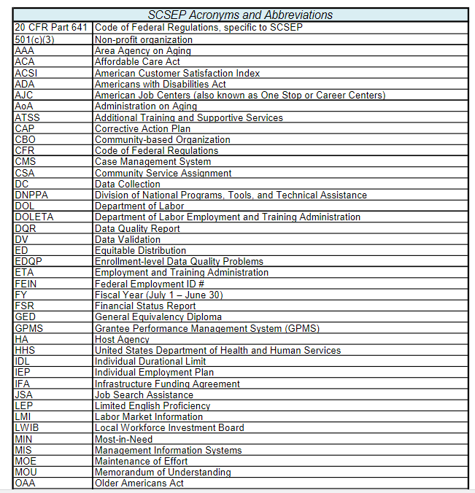
SCSEP Acronym and Abbreviation Reference Sheet – saved in Sharefile

Slide 21
Policy and Guidance Resources
Governing guidance:
As a federal program, SCSEP has multiple sources for regulations, policies, and other forms of guidance that help structure the program.
Federal Guidance resources
20 Code of Federal Regulations, Part 641
DOL Data Collection Handbook, Rev. 7
DOL Supplement to the Data Collection Handbook
DOL Data Validation (DV) Handbook (PY2022)
DOL Training and Employment Guidance Letters (TEGLs)
The Center’s Guidance resources
The Center also has our own Policy and Procedure Manual and program forms
Annual Workforce Inclusion Grant Agreement

Slide 22
Workforce Inclusion Grant Agreement
Formerly called the “Sponsor Agreement”
Spells out the terms of the agreement between the Center as a national SCSEP grantee and your agency, as the subgrantee.
The Grant Agreement is updated and sent out to the subgrantee’s Executive Director annually and includes:
Funding, guidelines for spending allocations
Performance goals
Federal regulations
Rules on reporting, record keeping, use of funds, staffing, etc.
Assurances and Certifications
Budget Proposal and Instructions

Slide 23
CWI Partner’s Page
Also known as the SCSEP Portal
Live demonstration of SCSEP Portal Forms and Information, and Policy and Procedures Manual resources page

Slide 24
Questions?

