Slide 1
Entering Quarterly Community Service Hours in the Grantee Performance Management System (GPMS)
Presented by: Alicia Black, Program Officer
June 18, 2024

Slide 2
Entering quarterly hours is a grant requirement
From the Center for Workforce Inclusion’s PY2023 Workforce Inclusion Grant Agreement, subgrantees are required to:
Enter older job seeker data directly into the GPMS from the Participant Job Seeker Form, Community Service Assignment Form, Exit Form, and Unsubsidized Exit form within 5 workdays of completing the form(s), and community service hours, follow-ups for unsubsidized placement, etc., as required.

Slide 3
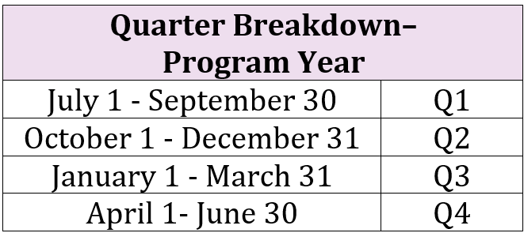
Entering quarterly hours is a grant requirement
Subgrantees total and enter Community Service Assignment (CSA) hours in GPMS at the end of each quarter. The Department of Labor notifies SCSEP grantees of quarter closeout dates for GPMS data entry purposes.

Slide 4
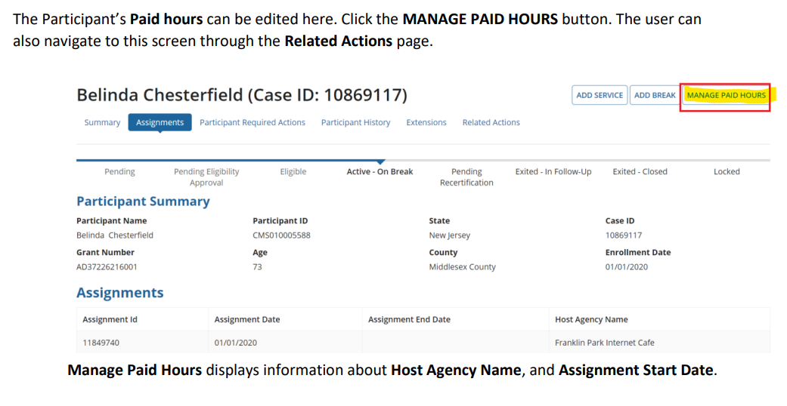
Entering CSA Hours: Option – Using Manage Paid Hours for an individual record
When working in an individual job seeker’s case, you can select Assignments, then select Manage Paid Hours.
The user can also navigate to this screen through the Related Actions page.

Slide 5
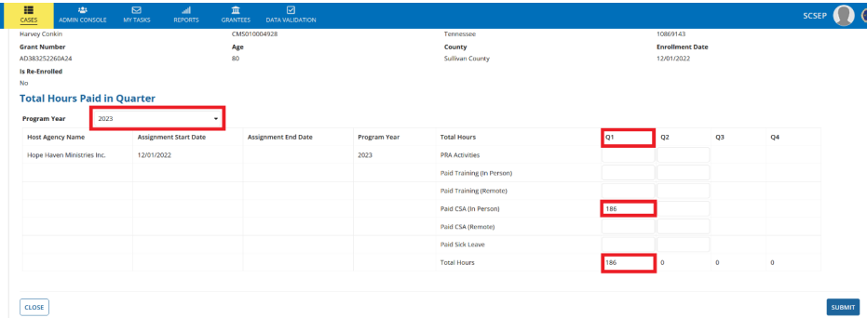
Entering CSA Hours:
Option – Using Manage Paid Hours for an individual record (continued)
Enter the number of hours for each activity in the associated quarter. Once the number of hours has been entered, the Total Hours Gets updated. Click Submit to save the data entered.

Slide 6
GPMS - Categories of Hours
Participant Required Actions (PRA) - Actions that are required once the participant has been assigned including the orientation, the offer of physical exam, the assessment, re-assessment and other service needs.
Paid Training (in person) – this is for all jobseekers who complete training to improve skills/employability in lieu of a Community Service Assignment and do so in person. Example: a computer training course program at a local Community College – if the job seeker is attending the training course in person at the Community College, it would be counted as Paid Training (in person).
Paid Training (remote) – this is for all job seekers who complete training to improve skills/employability in lieu of a Community Service Assignment but they do it from home or some other site. For example, you’d enter hours in this category if a job seeker was enrolled in an online computer training course through the Community College and they did their course work from home, a nearby library, the Career Center, etc.
Paid CSA (in person) - this will likely be the most common category you enter for – it is for all job seekers placed in Community Service Assignments at a Host Agency (501c3 nonprofit orgs or government/public agencies) that they report to in person and complete their training hours on-site.
Paid CSA (remote) – this is for all jobseekers who are placed in Community Service Assignments with a Host Agency that conduct their training from home, but they are completing work on behalf of the Host Agency. These assignments are likely very few, if any, because not many CSAs can be converted into remote arrangements. It is allowable though!
Paid Sick Leave – this will vary from state to state – some states have employment laws that are extended to SCSEP job seekers that make them entitled to paid time off due to illness.

Slide 7
Entering CSA Hours:
Option - Using the Admin Console for data entry for all active job seekers
Users can update the hours for multiple job seekers through the Manage Paid Hours utility via the Admin Console.
Once the user selects a Program Year that has not been frozen, all job seekers active within that Program Year are listed on the screen.
The hours can be entered for the quarters in which a job seeker was active.
Quarters in which a job seeker was not active, for example, when they are on a break in service or have exited the program, will be grayed out, and hours for those quarters cannot be entered.

Slide 8
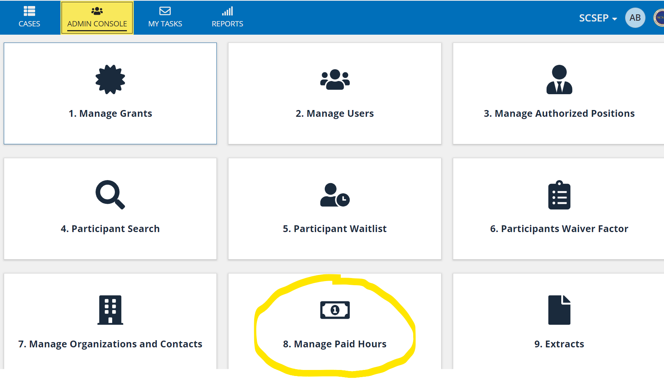
Entering CSA Hours:
Option - Using the Admin Console for data entry for all active job seekers

Slide 9
Entering CSA Hours:
Option - Using the Admin Console for data entry for all active job seekers (continued)
Written Instructions
1. From the SCSEP Cases page, click on the Admin Console tab at the top.
2. Scroll down to “8. Manage Paid Hours” and select.
3. Complete the Required Filters (Grantee, Subgrantee, Program Year)
4. Tab or click outside the box.
5. This makes the Reset and Search buttons appear; click Search.
6. Job seekers Active in the selected Program Year will appear under the column Participant Name, with rows for entering different types of hours for each quarter.
7. Note: If you are a Case Manager, you will only be able to enter data for job seekers assigned to you. If you are a Supervisor, you will be able to enter data for job seekers assigned to any Case Manager under your supervision in GPMS.
8. Enter the appropriate hours in the appropriate quarter for each job seeker.
9. Depending on the number of job seekers listed, you may have to click “Save” at the bottom then use the Next arrow to tab the next page of job seekers.

Slide 10
Entering CSA Hours:
Option - Using the Admin Console for data entry for all active job seekers

Slide 11
Entering CSA Hours:
Option - Using the Admin Console for data entry for all active job seekers (continued)

Slide 12
Hours – rounding rules!
In GPMS, you can only enter CSA hours in whole hour increments.
Rounding rules:
Anything .5 and up, round up
Anything .5 and down, round down

Slide 13
THANK YOU!

