Slide 1
SCSEP IEP and GPMS Data Entry Additional Training and Supportive services (ATSS) October, 2024

Slide 2
Example
Ted wants a job working in a warehouse as a shift supervisor. The job that he wants requires him to be able to have basic computer skills and steel toed boots.
Ted is currently preparing to enter an OJE for this position and needs support to get the computer skills and steel toed boots.
Ted’s Case Manager asks Ted if he’ll be able to get boots, and he answers no, their too expensive. She then calls the local clothes closet, where she often gets clothing items, to see if they have any size 13 steel toed boots. They do not. She will access ATSS funds for the boots.
The Case Manager knows she can get Ted into one of the upcoming Center DCP Cohorts to learn basic computer skills. DCP is also covered by ATSS funds.

Slide 3
Updating the IEP

Slide 4
IEP UPDATE
1. A Long-Term Employment Goal must be identified and the Training/ Support Service being requested must support the Employment Goal.

Slide 5
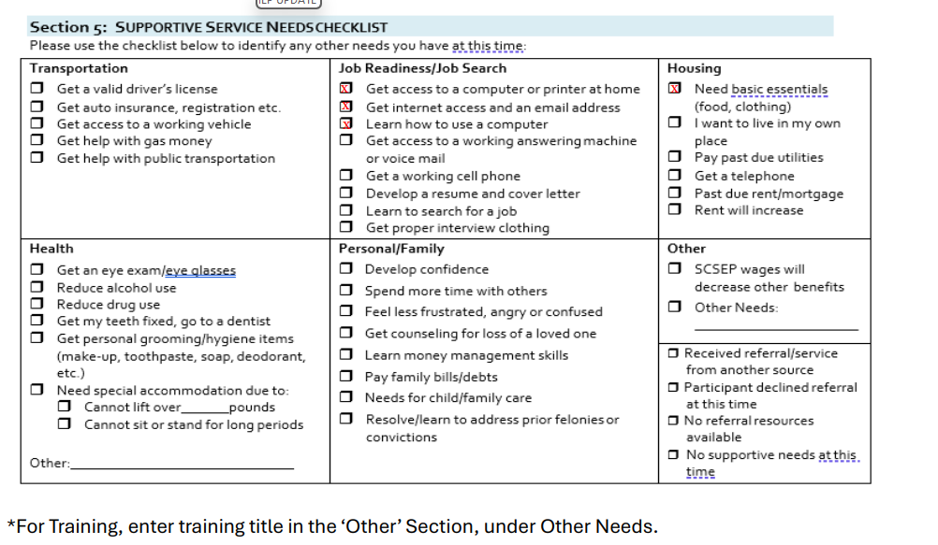
IEP UPDATE
2. Supportive Service Needs Checklist/Update

Slide 6
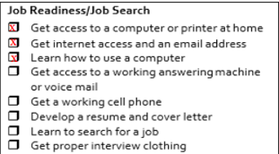
Job Readiness/Job Search

Slide 7
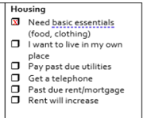
Housing

Slide 8
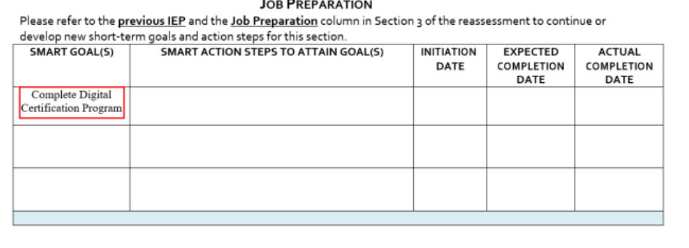
IEP UPDATE
3. If a Job Seeker is requesting ‘Training’, update the Smart Goal to complete a specific training, such as DCP

Slide 9
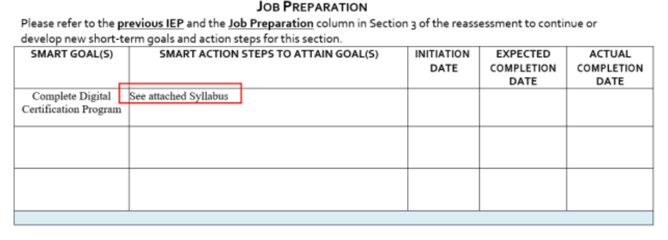
IEP UPDATE
4. Enter Smart Action Steps to describe the training or attach a syllabus

Slide 10
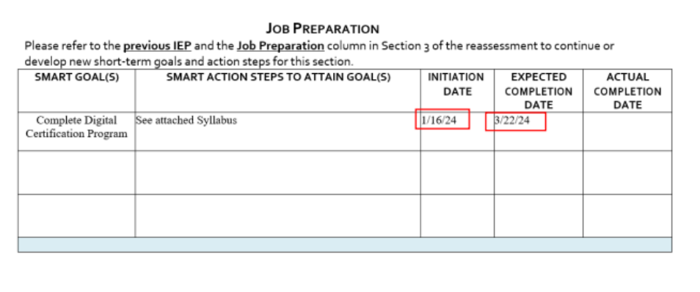
IEP UPDATE
5. Enter Initiation and Expected Completion Dates

Slide 11
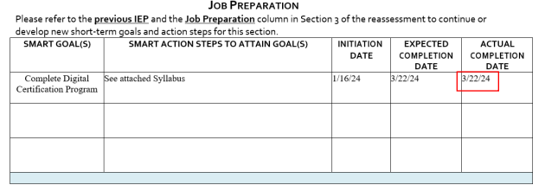
IEP UPDATE
6. Enter Actual Completion date once the training is completed

Slide 12
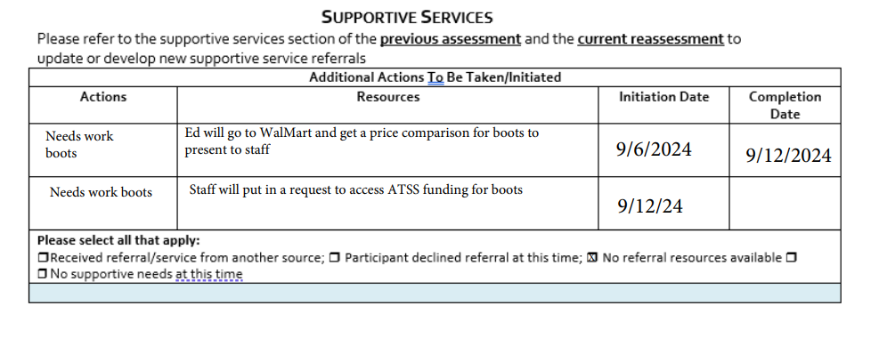
IEP UPDATE
Entering a Supportive Service -

Slide 13
Entering into GPMS

Slide 14
Entering ATSS into GPMS
Log into GPMS
Go to CASES
Click on + Show Filters

Slide 15
Entering ATSS into GPMS
4. Make sure Status is ‘Active’
5. Select Center for Workforce Inclusion for Grantee
6. Select your grant for Sub-Grantee
7. Clear Enrollment From Date
8. Click on ‘SEARCH’

Slide 16
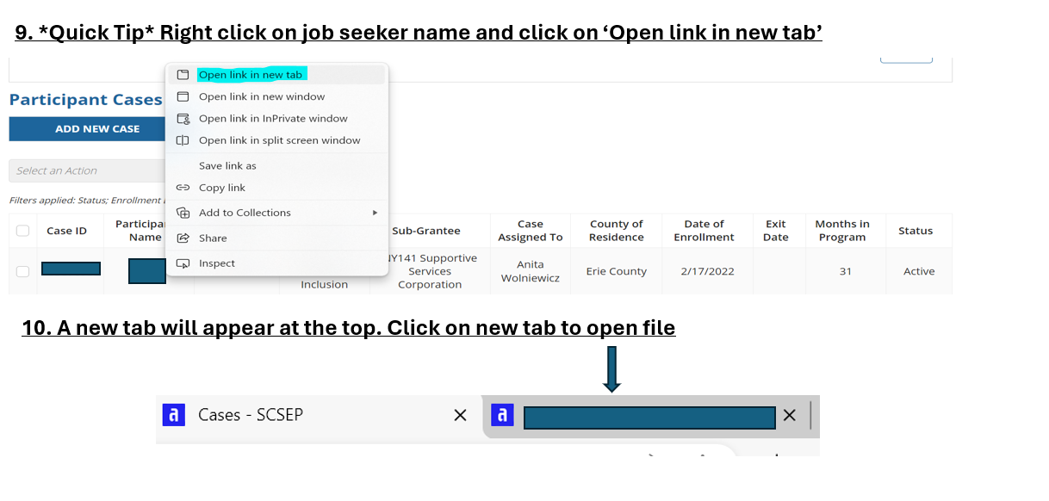
Entering ATSS into GPMS

Slide 17
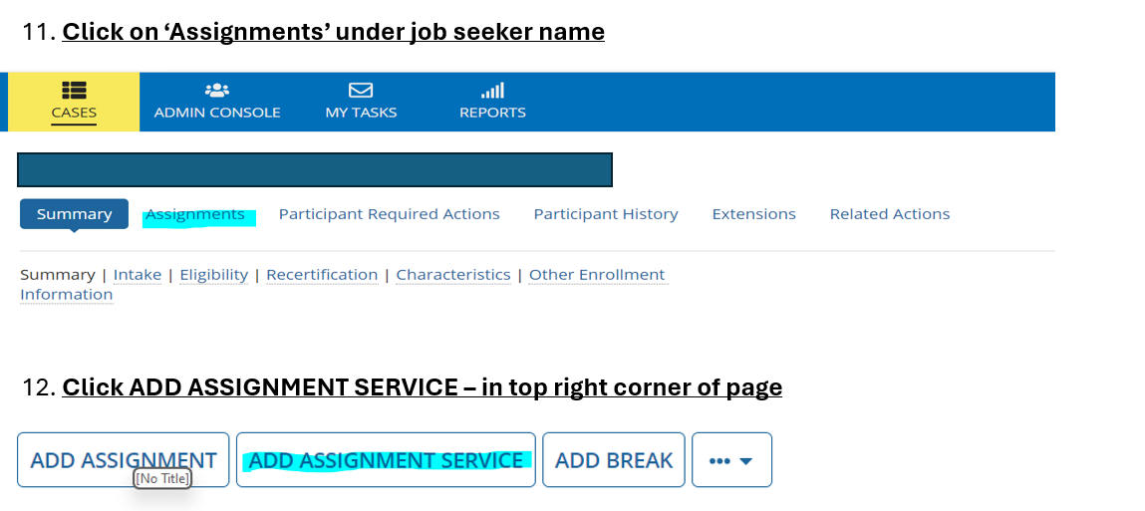
Entering ATSS into GPMS

Slide 18
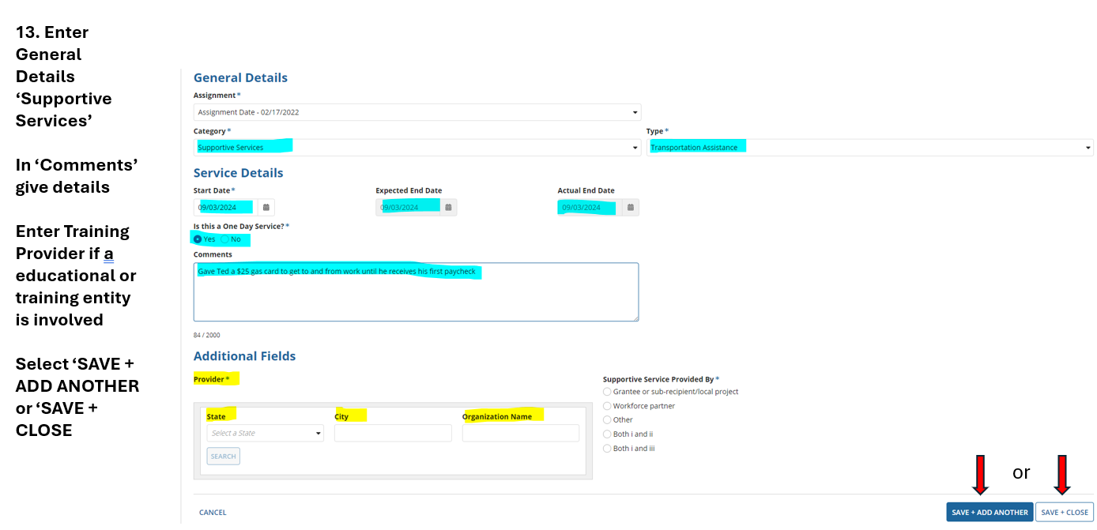
Entering ATSS into GPMS

Slide 19
Ending ATSS in GPMS
Log into GPMS
Go to CASES
Click on + Show Filters

Slide 20
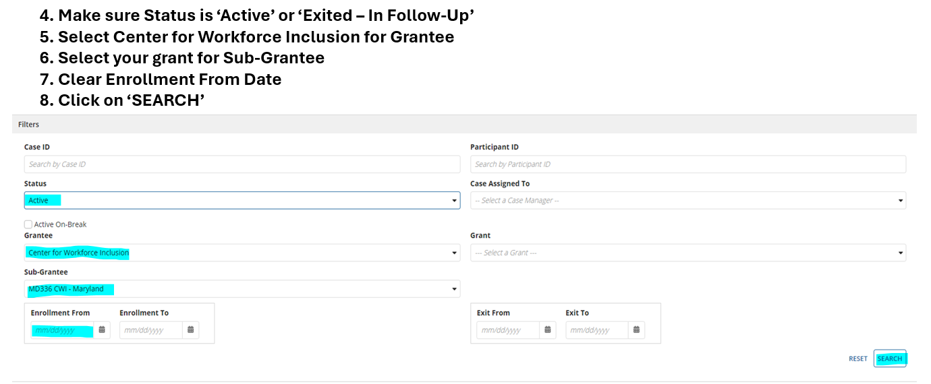
Ending ATSS in GPMS

Slide 21
Ending ATSS in GPMS
9. *Quick Tip* Right click on job seeker name and click on ‘Open link in new tab’
10. A new tab will appear at the top. Click on new tab to open file

Slide 22
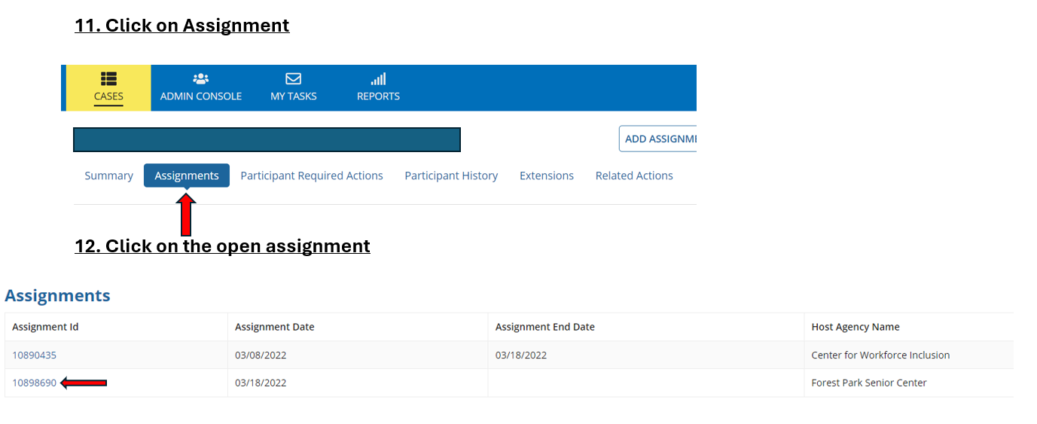
Ending ATSS in GPMS

Slide 23
Ending ATSS in GPMS

Slide 24
Ending ATSS in GPMS

Slide 25
Ending ATSS in GPMS

Slide 26
Questions? Thank you!

